Slide 1

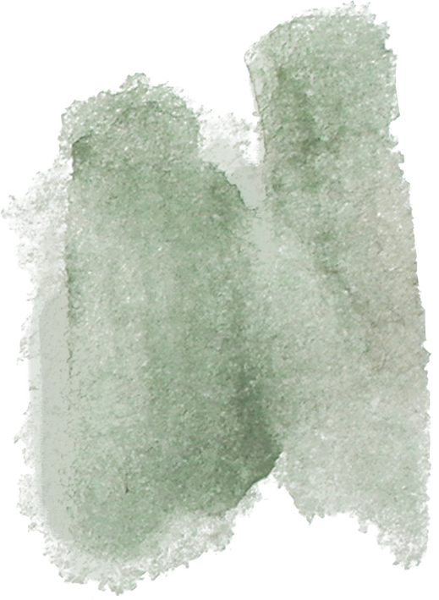







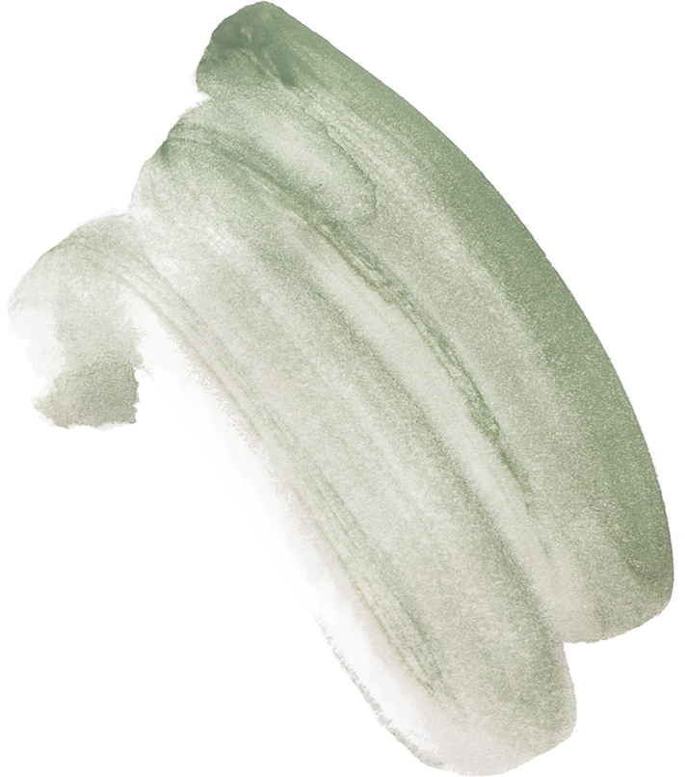

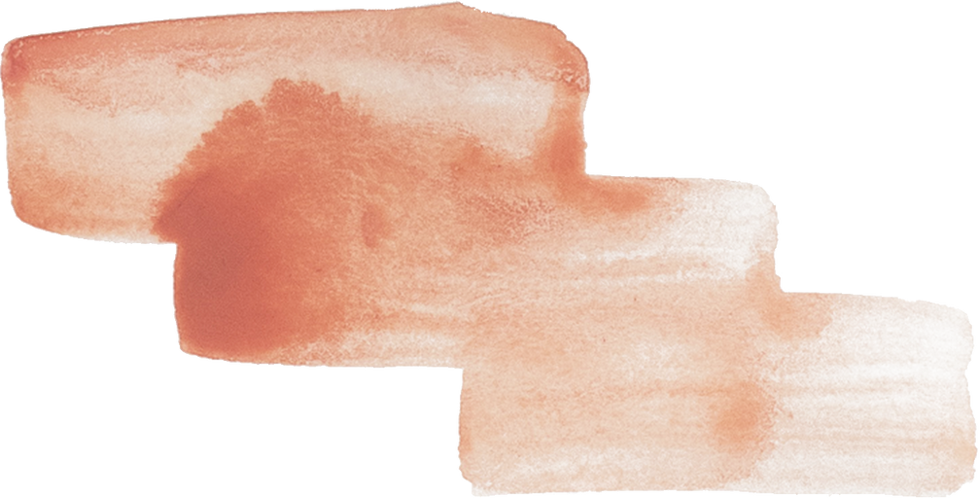
StaySharp
Anti-Drowsiness Monitoring

Slide 2
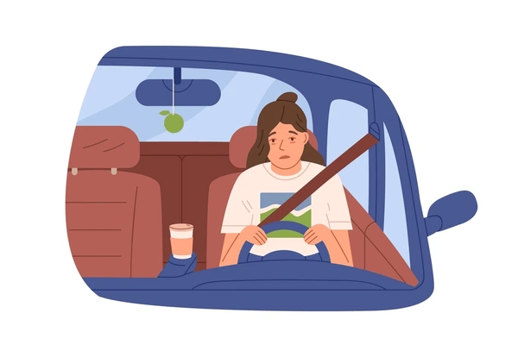
Risks of Fatigued Driving
In Canada, fatigue is a factor in about 20% of fatal collisions annually, according to the Canadian Council of Motor Transport Administrators (CCMTA) [1].
Drowsy driving impairs reaction time, decision-making, and awareness, increasing the risk of accidents
Impact on Road Safety
Fatigue-related crashes lead to severe injuries and fatalities, particularly among long-haul and night-shift drivers [1].

Slide 3

Goal
detect patterns of drowsiness, stress, and alertness in real time, helping gauge the driver’s alertness level
Our program uses real-time heart rate data from wearable devices to detect driver drowsiness, helping prevent accidents and enhance road safety.
HEART RATE METRICS
Features
Heart Rate Monitoring: Simulates heart rate and heart rate variability (HRV) patterns.
Drowsiness Detection: Assesses drowsiness levels and categorizes them by severity.
Alerts: Issues critical alerts to keep users attentive and safe.
Daily Report: Summarizes daily drowsiness patterns, allowing users to identify trends and make adjustments to improve alertness.
Alerts through vibrations (wearables) and notifications.
ALERTS

Slide 4
Test Run

Slide 5
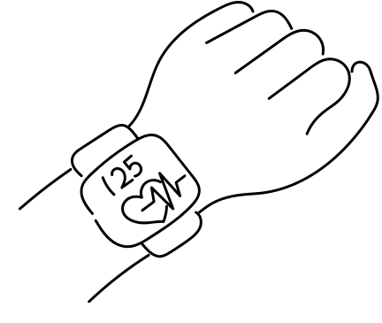
Challenges Faced
Limited Access to Real Data
Privacy restrictions from wearable APIs (such as Google Fit and Fitbit) prevent real-time access to user heart rate data.
2. Data Simulation
Simulating realistic heart rate patterns is essential for our project; however, achieving accurate, lifelike data remains a challenge at this stage.

Slide 6

Future Goals/Scalibility
Enhanced Data Quality: We will leverage a proprietary device optimized for precise heart-rate data collection to improve the accuracy of our machine learning model for drowsiness detection.
Broad Compatibility: Our solution will also support popular wearable devices, like the Apple Watch and other mainstream wearables, ensuring wide accessibility and ease of integration.

Slide 7
Citations
[1] Canadian Council of Motor Transport Administrators, "Fatigue-Related Collisions," [Online]. Available: https://ccmta.ca/en/fatigue-related-collisions.

Slide 8
THANK YOU VERY MUCH!

